Slide 1




INTELLIGENT
TAXI ROUTE OPTIMIZATION
USING REINFORCEMENT LEARNING
Optimizing Taxi Routes using DQN, Dijkstra & A*
SUBMITTED TO - MS.KHUSHI RATTAN(IBM)
SUBMITTED BY-
Jashandeep Singh 72510438(CTU2500040)
Harshpreet Singh Malhi — 72520287(CTU2502005)

Slide 2















PROBLEM
STATEMENT
Taxi routing must balance distance, time, traffic, and operational cost
Traditional shortest-path methods rely on fixed, static costs
Traffic conditions are dynamic and unpredictable
TAXI
ROAD NETWORK
TRAFFIC CONDITIONS
ROUTE DECISION
DESTINATION
Reinforcement learning enables adaptive route decisions through environment interaction

Slide 3















OBJECTIVES
Develop an intelligent taxi route optimization system
Compare Dijkstra, A* and DQN algorithms
Incorporate simulated dynamic traffic conditions
Optimize multiple objectives: cost, distance, travel time
Provide comparative route analysis and quantitative evaluation
Provide training analytics for the reinforcement learning model
Build a web-based interactive dashboard

Slide 4



















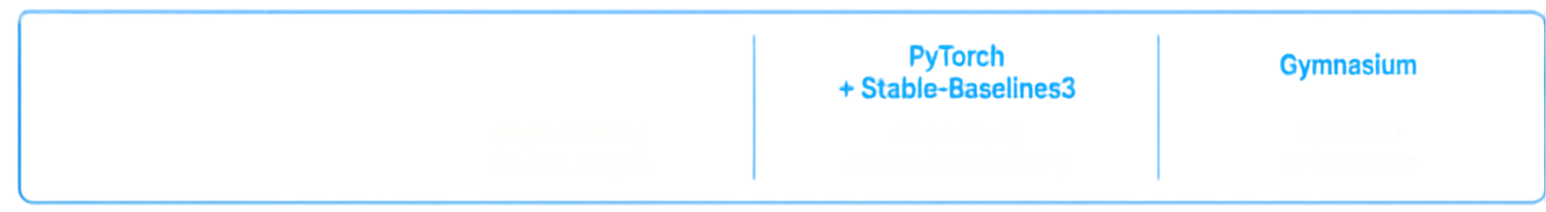
SYSTEM ARCHITECTURE
end-to-end flow of the intelligent taxi route optimization system
USER
FRONTEND
API LAYER
ROUTING & OPTIMIZATION
ENVIRONMENT
SIMULATION & METRICS
OUTPUT
Dijkstra
A*
DQN
User
Next.js + TypeScript
FastAPI REST API
Taxi Environment Road Network
Traffic Simulation Route Metrics
Results Dashboard
trip request preferences
web interface visualization
request handling data exchange
dynamic state interactions
route planning decision making
performance evaluation feedback loop
insights visual reports
TECHNOLOGY STACK
OpenStreetMap
+ Leaflet
Python
+ NetworkX
PyTorch
+ Stable-Baselines3
Gymnasium
maps & visualization
graph modeling network analysis
deep learning reinforcement learning
simulation environments

Slide 5


















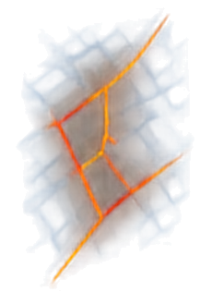









METHODOLOGY
A stepwise framework that integrates classical routing algorithms with deep reinforcement learning to recommend optimal taxi routes.
1
2
3
4
5
6
7
8
Input pickup and destination
Construct / load road network
Apply traffic conditions
Calculate route using classical algorithms
Let DQN interact with taxi environment
Calculate distance, ETA, operational cost
Compare algorithm results
Recommend algorithm based on optimization objective
Dijkstra
Distance
A*
ETA Operational Cost
Best Algorithm

Slide 6











REINFORCEMENT LEARNING & DQN
STATE
current location, destination, and traffic environment
DQN learns to choose the best route through trial and feedback
REWARD
ACTION
It observes the current state, takes an action, and receives a reward
positive for efficient movement, penalize extra distance, time, cost
select next road or node
DQN AGENT
The agent improves its policy to select routing actions that minimize time, distance, and cost
ENVIRONMENT
real-world traffic and road network
NEURAL NETWORK
EXPERIENCE REPLAY
TARGET NETWORK
Q-VALUE
approximates Q-values for state-action pairs
stores past experiences and samples for stable learning
uses delayed updates to stabilize training
expected return of an action from a given state

Slide 7


CLASSICAL
BASELINES
APPROACH
TYPE
MAIN PRINCIPLE
STRENGTH
LIMITATION
Exact
shortest-path
No heuristic needed
Reliable baseline
Computationally intensive on large graphs
Dijkstra
Heuristic guided search
Uses heuristic to prune search
Efficient with good heuristic
Depends on heuristic quality
A*
Learns routing policy by interaction
Adapts to dynamic environments
Requires training, less predictable
DQN
Learning-based

Slide 8















TECHNOLOGY STACK & IMPLEMENTATION
FRONTEND
BACKEND
AI / ML
Next.js TypeScript Tailwind CSS Leafet
FastAPI
Python
REST API
PyTorch
Stable-Baselines3
Gymnasium
ROUTING
MAPS & DATA
DEPLOYMENT
NetworkX
Dijkstra
A*
OpenStreetMap
Synthetic taxi-trip data
Traffic simulation
Vercel
Render
GitHub

Slide 9

















RESULTS & DASHBOARD
INTELLIGENT TAXI ROUTE OPTIMIZATION
SIMULATED
ROUTE DISTANCE
ROUTE COMPARISON
12.7 km
DQN (Selected)
ESTIMATED TIME (ETA)
23 min
12.7 km • 23 min • • 145
Live system dashboard showing optimized route, key outputs, and algorithm comparison in a simulated environment.
OPERATIONAL COST
A*
₹145
ROUTE STEPS (NODES)
12.3 km • 24 min • • 148
16
Dijkstra
ALGORITHM EXECUTION TIME
300 ms
12.5 km • 25 min • • 150
AI ROUTE EXPLANATION
TRAFFIC CONDITIONS
Selected route balances lower congestion and traffic signals to minimize total travel time and cost.
LOW
MODERATE
NIGH
EXAMPLERUNTIME OUTPUT FROM THE DEPLOYED SYSTEM
Values are illustrative and from simulated environment, not real-world results.

Slide 10




CONCLUSION & FUTURE SCOPE
We built an intelligent taxi routing platform
Classical algorithms set a strong baseline
DQN brings reinforcement learning to routing
End-to-end system with simulation, AI, and dashboard
A modular architecture ready for future innovation
THANK YOU
QUESTIONS?

